Slide 1
COMP 3069
Computer Graphics
Lab 1 Exercises
Autumn 2018

Slide 2
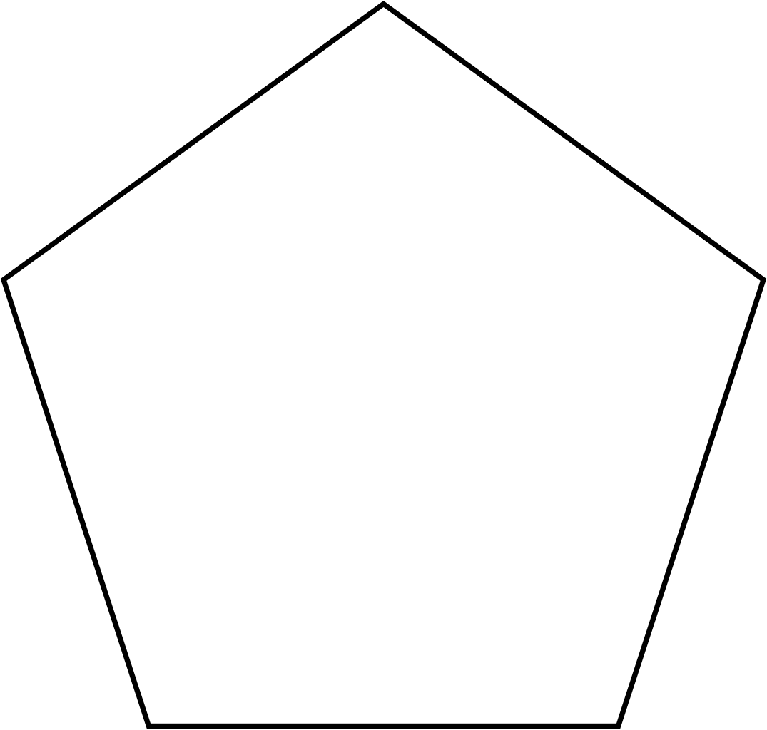
Exercise 1: Draw a Polygon
Draw a regular pentagon using OpenGL.

Slide 3
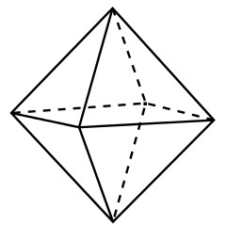
Exercise 2: Draw a Octahedron
Draw an octahedron such that each face is colored with a different color.

